Slide 1
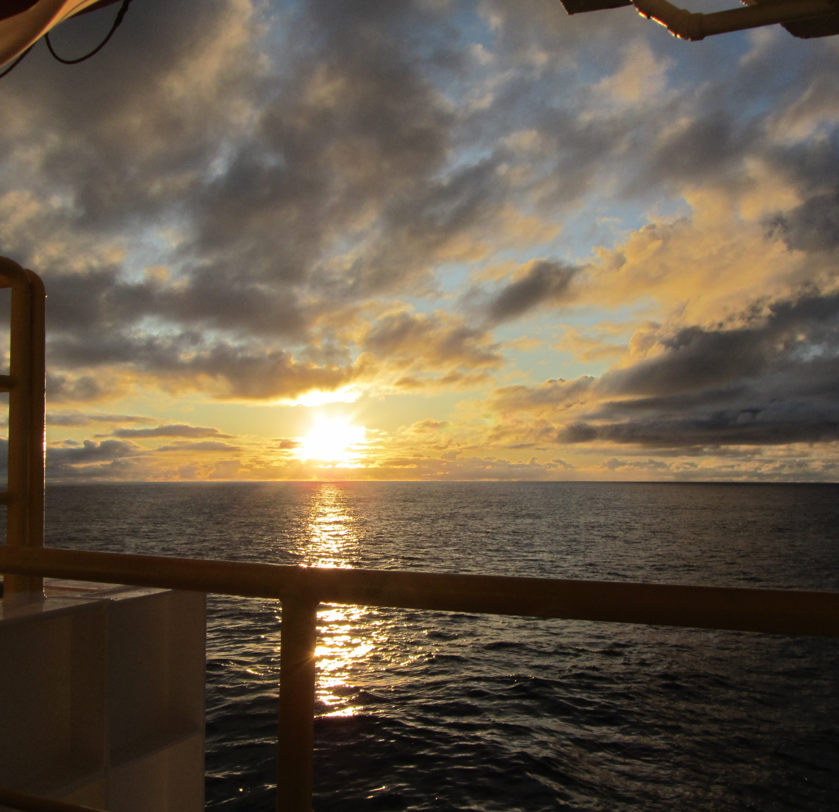
Marine Geology
Dr Julia Reece
GET STARTED
www.futurumcareers.com

Slide 2
In this presentation:
Meet Julia
Submarine landslides
Microfossils
Julia’s lab experiments and computer models
Talking points
The International Ocean Discovery Program
Pathway from school to marine geology
Explore careers in marine geology
Talking points
02 futurumcareers.com

Slide 3
Meet Julia
Julia is a marine geologist at Texas A&M University in the US.
She is using a combination of lab-based experiments and computer models to investigate whether microfossils play a role in initiating submarine landslides.
Learn more about her work…
Dr Julia Reece
03 futurumcareers.com

Slide 4
Submarine landslides
Submarine landslides are underwater landslides.
They occur on the continental margin, the slope that exists between the shallow waters surrounding continents and the deep ocean.
If sediment deposited on the seafloor becomes unstable, it may collapse as a submarine landslide.
Seafloor sediment composed of microfossils
“Submarine landslides pose a significant risk to coastal communities and seafloor infrastructure, as they can generate tsunamis and destroy subsea cables and pipelines.” – Julia
04 futurumcareers.com

Slide 5
Microfossils
“Microfossils are often smaller than a grain of sand and can only be inspected with a microscope.” – Julia
In the ocean, single-celled organisms produce outer mineral skeletons composed of calcite or silica.
When the organisms die, their tiny skeletons fill with seawater and sink to the bottom of the ocean where they join the sediment accumulating on the seafloor.
A high-resolution image of a marine diatom
05 futurumcareers.com

Slide 6
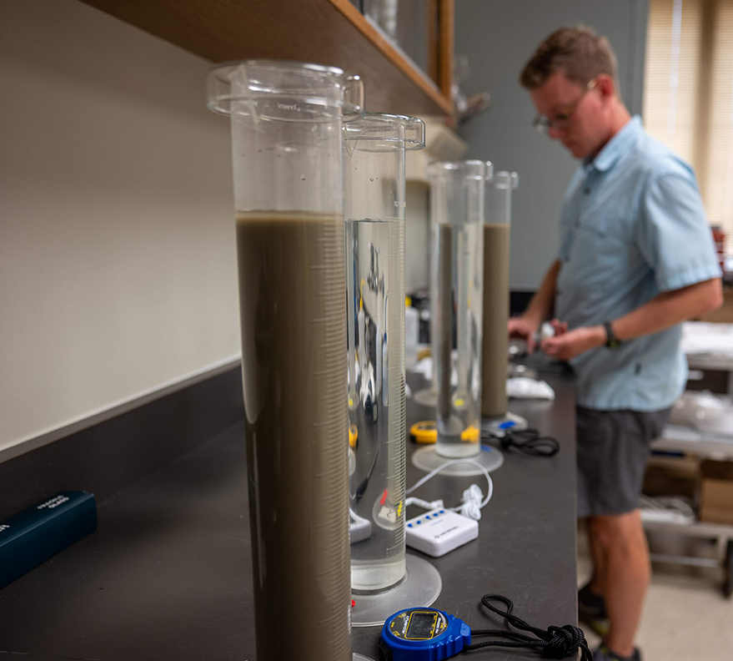
“If microfossils are buried by impermeable clay-rich sediments, the clay will trap the water in the layer of microfossils.” – Julia
The microfossil-rich sediment layer could therefore act as a weak layer that is more prone to failure, acting as a plane to initiate submarine landslides.
Julia and her team are testing this hypothesis by using a combination of lab-based experiments and computer models.
Ryan Elmore conducts grain size analysis in the lab
06 futurumcareers.com

Slide 7
Lab experiments
Julia and her team conduct uniaxial consolidation tests on sediment samples, by compressing them vertically to simulate the natural burial conditions of seafloor sediments.
They then perform triaxial shear tests on each sample, by applying pressure in all directions then loading the sample until it fails.
“This tell us the shear strength of the sediment, which is a critical parameter in the stability of continental margin sediments” – Julia
Wyatt Scott performs a uniaxial consolidation test
07 futurumcareers.com

Slide 8
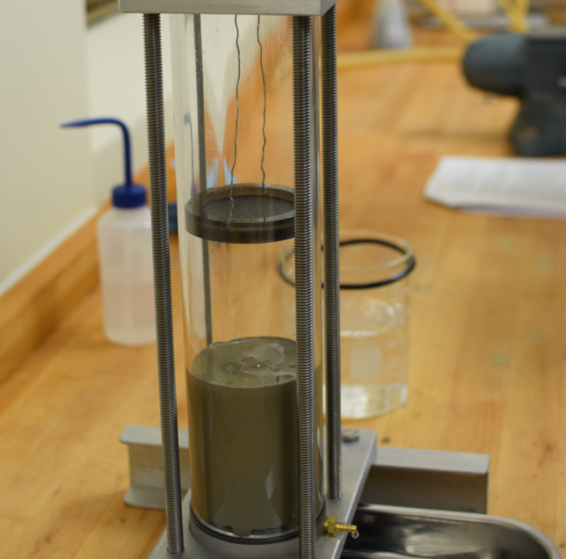
Computer models
“The results from our lab experiments become the input parameters to our numerical models, as they define the physical, mechanical and hydraulic properties of all sediment layers.” – Julia
Julia uses her lab results and powerful computer software to create models of sediment stability at a continental margin scale.
With these models, she can test the impact of different factors, such as the thickness of a weak layer of microfossils, on the stability of the sediment.
A resedimentation experiment
08 futurumcareers.com

Slide 9
“The most accurate and realistic geological understanding is achieved when experimental, numerical and field observations are integrated.” – Julia
Ideally, Julia would like to collect seafloor sediments from continental margins and submarine landslide deposits. This would allow her to test if her hypothesis about the role of microfossils in submarine landslides is correct.
In future, Julia hopes to use an International Ocean Discovery Program research ship to drill into the seafloor to collect this crucial last piece of the puzzle.
Sediment cores collected from below the seafloor
09 futurumcareers.com

Slide 10
Talking points
What are submarine landslides?
How might microfossils initiate submarine landslides?
How do Julia’s lab experiments influence her computer models?
What additional data does Julia want to collect to test her hypothesis?
If Julia’s hypothesis is correct, what would she observe in seafloor sediments from continental margins and submarine landslide deposits?
10 futurumcareers.com

Slide 11
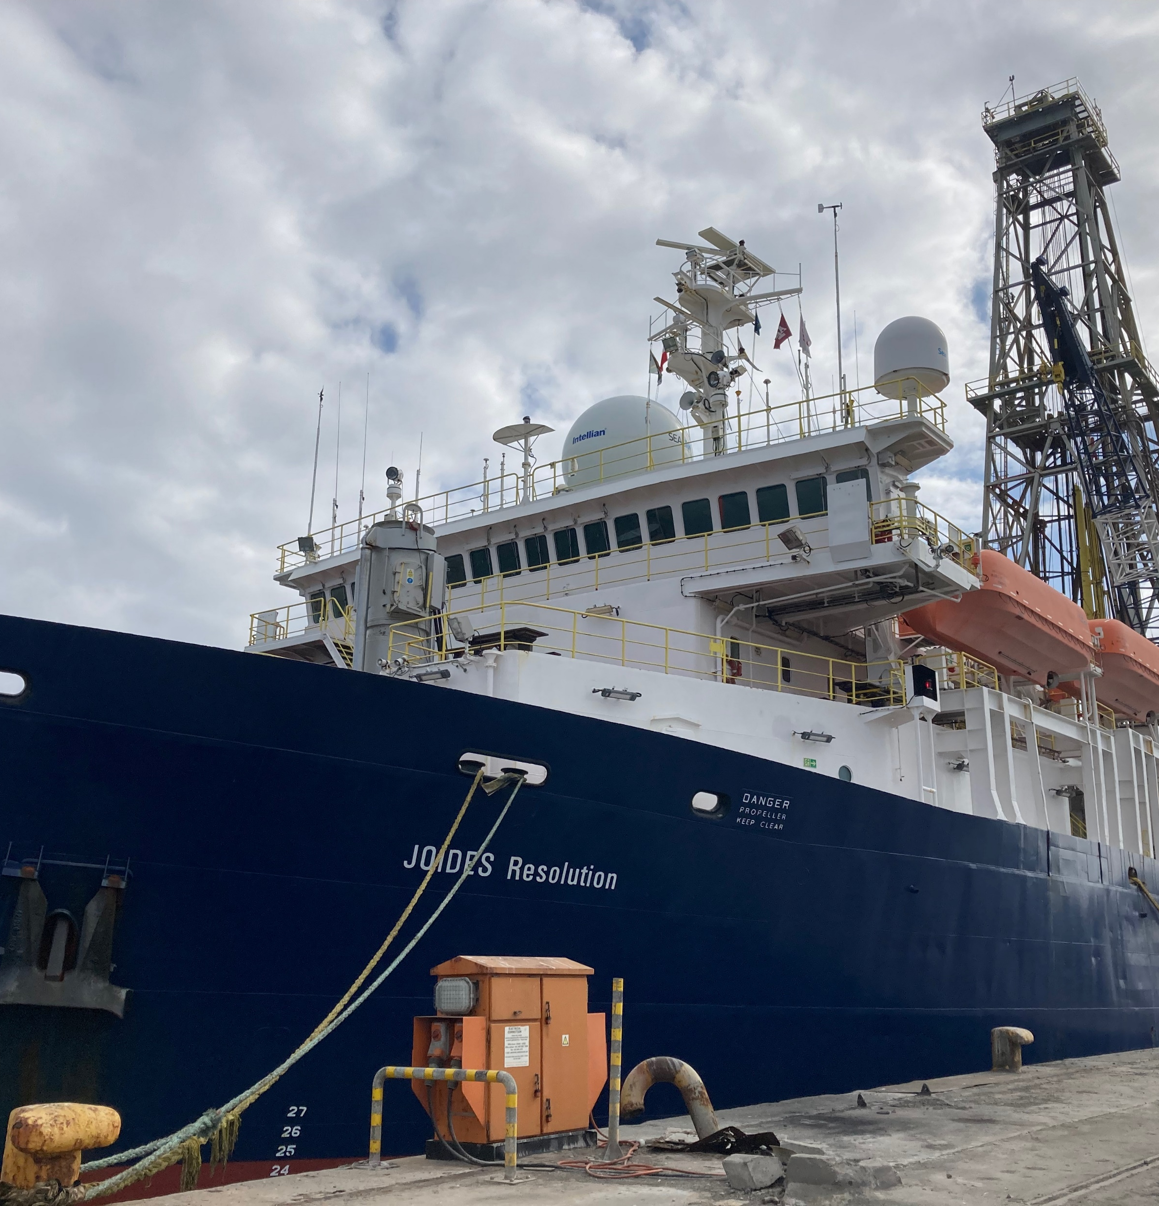
The International Ocean Discovery Program (IODP)
The IODP is a marine research collaboration to ‘explore the Earth under the sea’.
The IODP uses research ships such as the JOIDES Resolution to drill into the seafloor to collect samples of sediments, the rocks below them, the fluids flowing through them and the organisms living in them.
These expeditions generate data allowing scientists to uncover Earth’s geological, climatic and biological history.
11 futurumcareers.com
The IODP research ship, JOIDES Resolution

Slide 12
From June to August 2022, Julia sailed on the JOIDES Resolution as co-chief scientist for IODP Expedition 393. The expedition’s aim was to study how seawater-derived fluids change seafloor sediments and ocean crust.
“As co-chief scientist, my job was to ensure our scientific objectives were achieved. It’s extremely rare that everything goes smoothly on a two-month long expedition!” – Julia
The 27 scientists onboard the JOIDES Resolution worked in 12-hour shifts in labs to describe and analyse the sediment cores that were drilled from the seafloor, supported by technical staff and the ship’s crew.
Julia sent Styrofoam cups down to the bottom of the ocean in this blue mesh bag, where they shrunk due to the increased pressure
12 futurumcareers.com

Slide 13
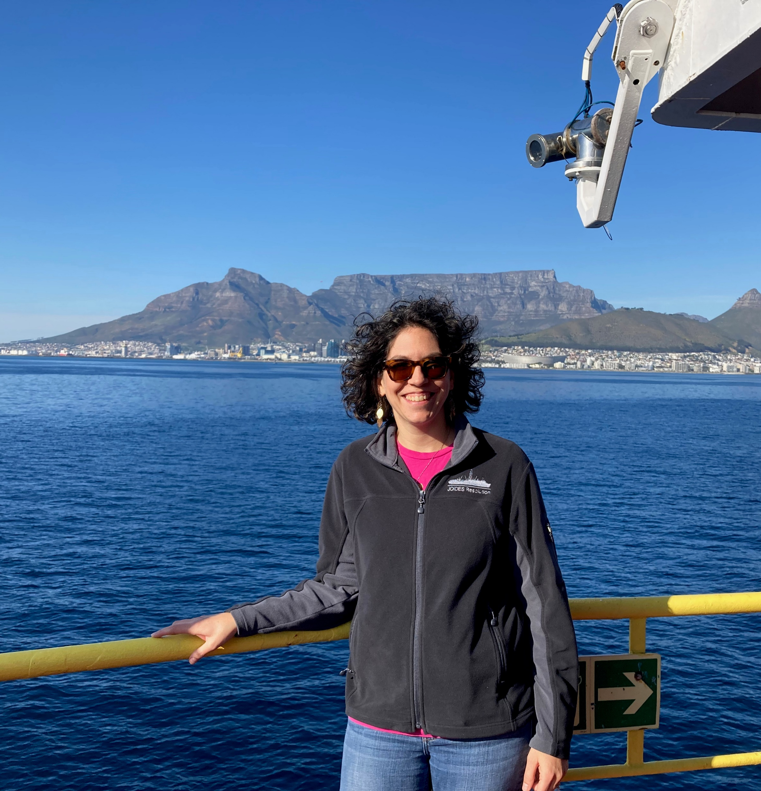
Julia in front of Table Mountain, prior to her arrival in Cape Town, South Africa, on the JOIDES Resolution
I have so many good memories of my time at sea!
It was exhilarating to see new cores pulled up from
the ocean floor and lay our eyes on sediment no one
had ever seen before.
We had fun onboard, with BBQs on deck and a special
feast for US Independence Day. Watching whales,
sunsets, night skies and bioluminescence were all
amazing experiences.
I look forward to analysing all the samples that I came
home with and synthesising the information we collected.
I hope to sail again someday so I can answer some of our outstanding questions about submarine landslides, by drilling through them and their undisturbed counterparts.
13 futurumcareers.com

Slide 14
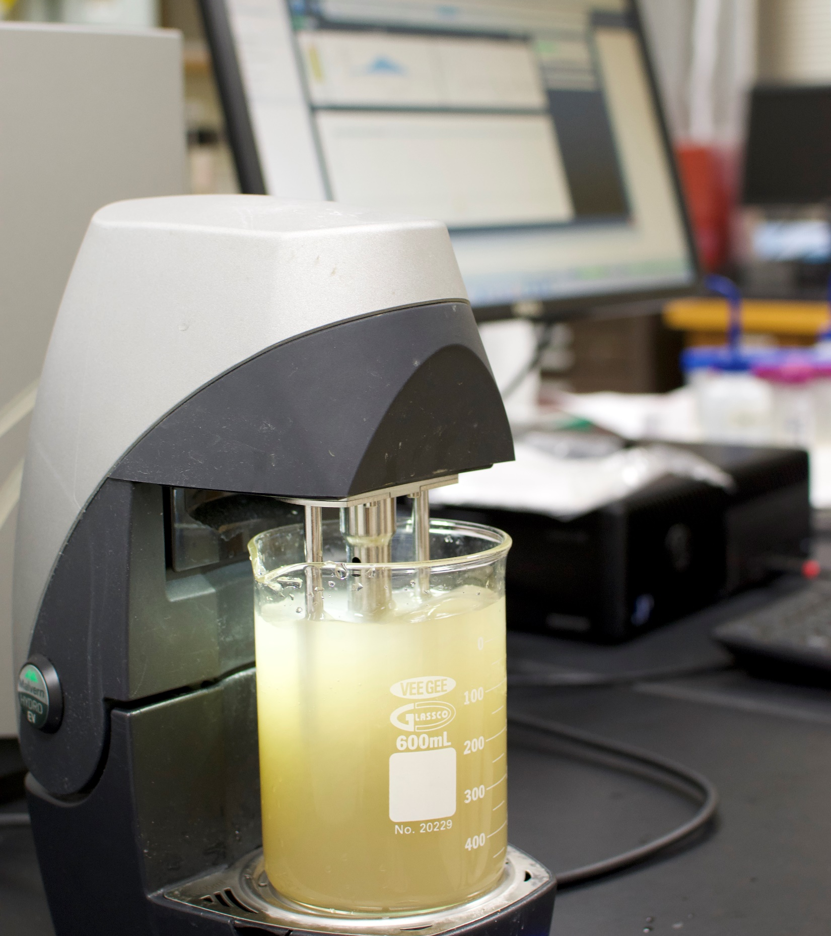
Pathway from school to marine geology
Grain size analysis in the lab
At school, study geography and any additional environmental or Earth science courses that are available.
At university, degrees in geology, oceanography, Earth science or geophysics could lead to a career in marine geology.
Julia recommends taking fundamental courses in mathematics, physics, chemistry and biology to ensure you have a strong base knowledge, as well as specialised geology courses in sedimentology, stratigraphy and oceanography.
14 futurumcareers.com

Slide 15
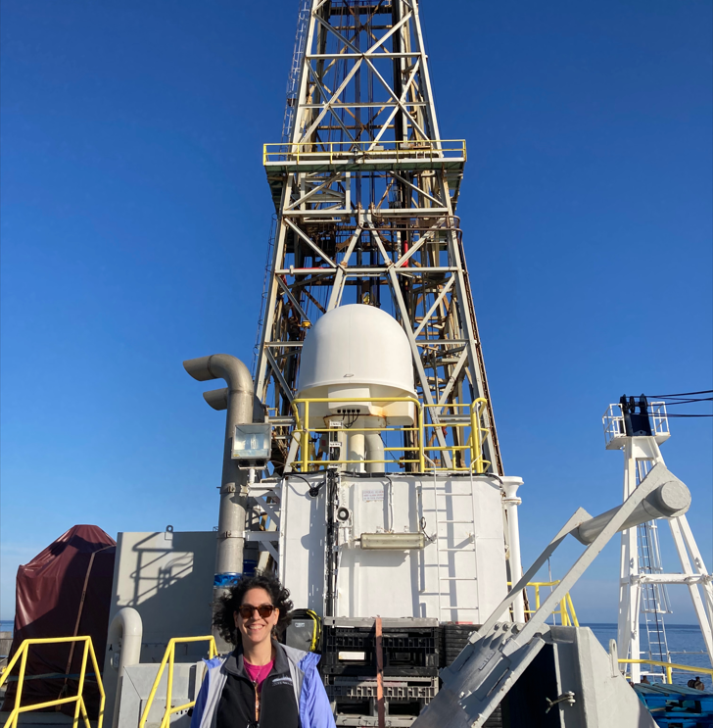
Julia stands in front of the derrick on the JOIDES Resolution
Explore careers in marine geology
The National Oceanic and Atmospheric Association
(NOAA) features profiles of people working in a range
of ocean exploration careers, from marine geologists
to the technicians who keep the research vessels sailing.
Environmental Science provides information about the
work you might do as a marine geologist, the qualifications
you will need and the salary you can expect.
If you are interested in marine expeditions, check out STEMSEAS (Science, Technology, Engineering and Math Student Experiences Aboard Ships), which allows high school graduates to participate in NSF-funded ocean research expeditions.
15 futurumcareers.com

Slide 16
Talking points
What did IODP Expedition 393 hope to discover?
What challenges do you think Julia may have faced as co-chief scientist for Expedition 393?
To what extent do you enjoy the specific subjects referred to on the ‘Pathway’ slide?
What do you think you would enjoy about participating in an ocean expedition?
What do you think you would find challenging about the experience?
16 futurumcareers.com

Slide 17
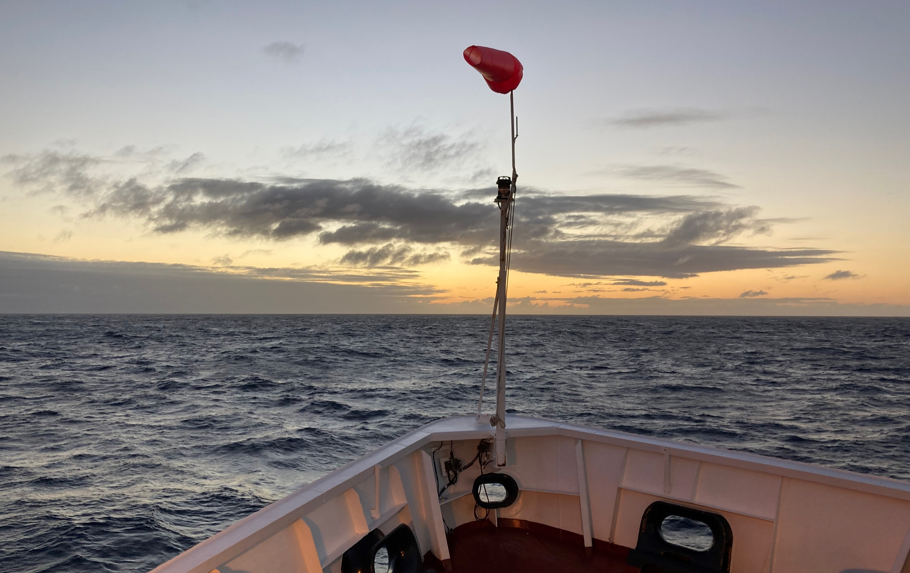
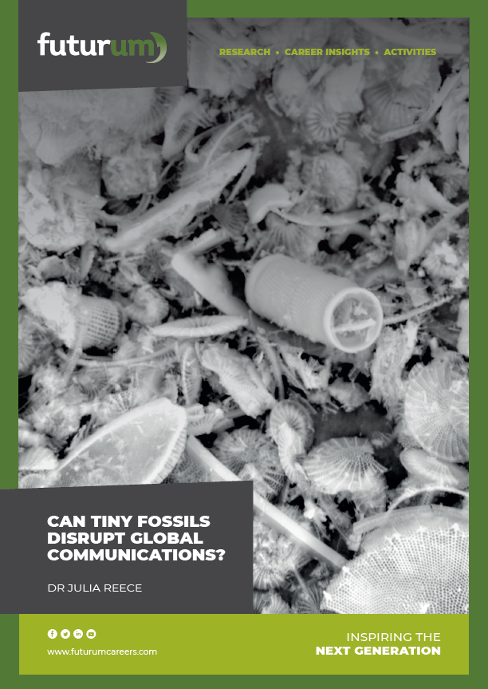
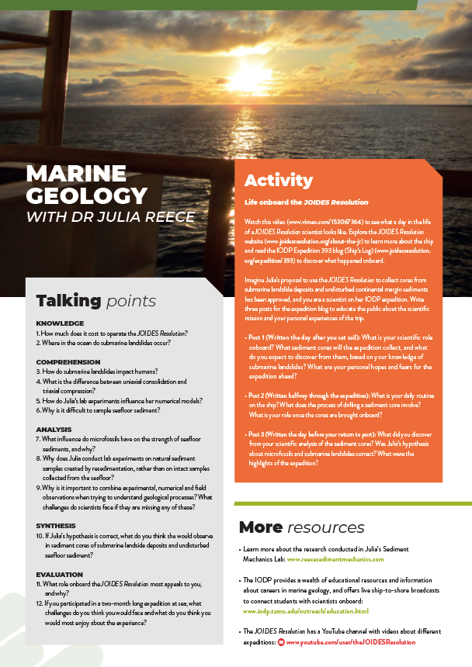
Resources
01
Download Julia’s article
02
Download her activity sheet
17 futurumcareers.com

Slide 18
18 futurumcareers.com

